Slide 1

Revenue Performance Insights & recommendations
Bright Coffee shop
Unlocking Revenue Growth Through Demand Optimisation and Product Uptake
REFILWE MOFOKENG
MARCH 2026

Slide 2
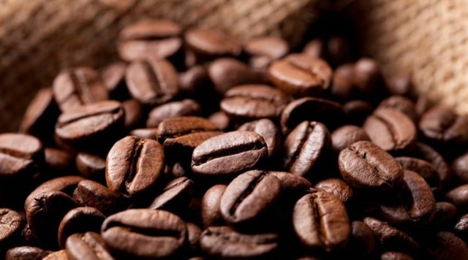
Content
01 EXECUTIVE SUMMARY
02 REVENUE OVERVIEW
03 REVENUE TREND OVER TIME
04 PRODUCT PERFORMANCE
05 RECOMMENDATION
2
Executive Summary
Revenue Overview
Revenue Trend Over Time
Customer Behaviour & Product Performance
Recommendation

Slide 3

Revenue growth is strong but constrained by demand concentration and suboptimal product utilisation, creating opportunities to drive targeted product uptake and expand demand across time periods
Executive Summary
Balanced Store Performance
Strong Revenue Growth
Revenue Concentrated in time & Product Categories
Underutilisation of Extensive Product Portfolio
Clear Opportunity to Optimise Demand
All stores contribute equally (~33%), indicating consistent execution and suggesting that performance is driven by broader customer behaviour rather than location-specific factors.
Revenue has more than doubled from January to June across all stores, reflecting strong momentum, though likely influenced by seasonal demand patterns rather than structural changes.
Revenue is heavily concentrated in weekday mornings, indicating dependence on commuter traffic and underutilisation of afternoons, evenings, and weekends.
Additionally, Coffee, tea, and bakery products dominate revenue (~78%), despite a wide and diverse product offering across multiple categories.
Despite having a broad range of products across categories (e.g., flavours, packaged goods, branded items), these contribute minimally to revenue.
Customers consistently default to a small subset of familiar products, suggesting that choice complexity is limiting broader product adoption.
Revenue growth will come from shifting customer behaviour through increasing visibility and uptake of existing products and activating underutilised time periods.

Slide 4
Revenue overview
Balanced store performance with no clear outperformer, indicating systemic (not location-specific) growth drivers
Total Revenue
R698 812.23
Astoria
Hell’s Kitchen
Lower manhattan
R232 243.91
R236 511.17
R230 057.25
33.23%
33.84%
32.92%
All three locations contribute roughly one-third of total revenue . Hell’s Kitchen slightly leads, but differences are not statistically meaningful
Suggests strong operational consistency and limited differentiation across locations
Growth opportunities should focus on network-wide strategies, not individual stores
4

Slide 5

Revenue trends over time
Revenue trends over time
Revenue has doubled over six months, indicating strong growth momentum potentially driven by seasonality and is concentrated in weekday mornings, highlighting reliance on commuter-driven demand and underutilised off-peak periods
Revenue has more than doubled from January to June
5.67%
0.45%
Growth trend is consistent across all store locations
13.69%
18.01%
7.81%
No single store is outperforming → growth is driven by broader demand patterns, not location-specific factors
13.69%
10.42%
23.27%
30.97%
Weekdays outperform weekends → demand driven by work/commuter behaviour
29.18%
Morning periods dominate revenue contribution across all stores contributing 45,19%, 58,96% and 62.55% in Astoria, Hell’s Kitchen and Lower Manhattan, respectively
Significant drop-off in evening, and night periods
33.83%
27.17%
24.95%
35.69%
31.58%
The business is experiencing strong growth, but it is highly dependent on weekday morning traffic and impacted by the underutilisation large portions of the day and weekends
01. Morning Rush
02. Mid-Morning
03. Afternoon
04. Evening
05. Night

Slide 6

Customer Behaviour & Product Performance
Revenue is highly concentrated in core beverage and bakery products, with limited contribution from secondary categories
5.74%
38.63%
10.36%
11.78%
28.11%
Revenue generation trend by product category is similar across all stores, with marginal variation
Highest performing products are Coffee, Tea and Baked Goods which contribute ~ 78.52% of total revenue
Transactions R50 and below
Underperforming products (Packaged Chocolates, Flavours, Loose Tea and Branded products) contribute < 6% of total revenue
Transactions between R50 and R200
Transactions greater than R100
Majority of transactions are low-value (≤ R50)
99.44%
Strong core offering → good foundation but untapped upsell and cross-sell potential

Slide 7
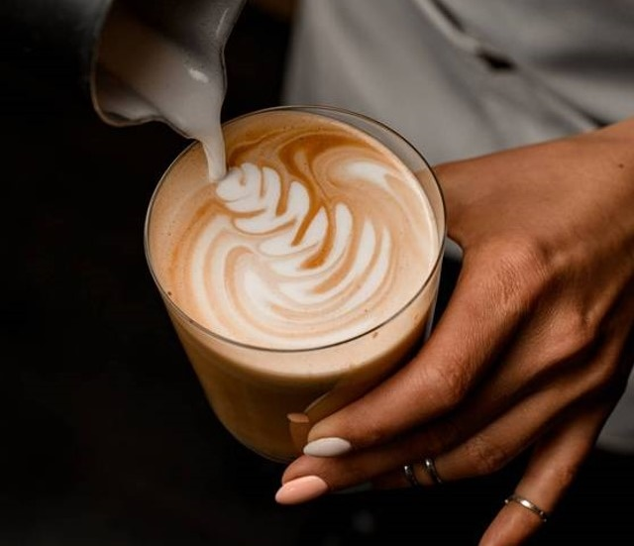





Recommendations
Introduce Loyalty Programmes
Optimise Product Mix
Activate Off-Peak Demand
Increase Average Transaction Value
Drive Product Uptake

Slide 8





ACTIVATE OFF-PEAK DEMAND
INCREASE AVERAGE TRANSACTION VALUE
SIMPLIFY CUSTOMER CHOICE TO DRIVE PRODUCT UPTAKE
INTRODUCE LOYALTY PROGRAMMES TO DRIVE RETENTION & FREQUENCY
OPTIMISE PRODUCT MIX
(GROW WEAK CATEGORIES, LEVERAGE STRONG ONES)
PROBLEM:
There is no structured mechanism to encourage repeat visits or build customer habits.
ACTIONS:
Launch a simple loyalty programme:
“Buy 5, get 1 free”
Digitise tracking (app or QR-based system)
Enable ability to order, earn and spend points on app
Explore the use of gamification
Added benefit – additional data points to drive targeted and personalised campaigns
Reward desired behaviours:
Extra points for off-peak purchases
Introduce tiered rewards:
Bronze → Silver → Gold customers and have discounts tied to the tiers
IMPACT:
Increases visit frequency & builds long-term customer value
PROBLEM:
Revenue is highly concentrated in a few categories; long-tail products underperform
ACTIONS:
Increase visibility of underperforming products:
Placement near checkout or high traffic areas
In-store awareness campaigns
“Try something new today”
Introduce pairing recommendations:
Coffee → pastry / syrup upgrade “Perfect with your coffee” positioning
Use menu cues and combos:
“Most people add…”
Staff-led subtle recommendations
Use limited-time features to create urgency
IMPACT:
Diversifies revenue & increases contribution from existing products
PROBLEM:
Revenue is heavily concentrated in weekday mornings
ACTIONS:
Introduce time-based offers/promotions:
“Afternoon pick-me-up” / “2-for-1 after 2pm”
Launch weekend-specific offerings:
Brunch menus, leisure-focused promotions
Expand product selection to align with seasonality:
Introduce iced coffee and blended beverages (e.g., frappés, iced lattes)
Position as refreshing afternoon alternatives
IMPACT:
Unlocks revenue from underutilised time periods
PROBLEM:
Majority of transactions are below R50
ACTIONS:
Introduce bundled offers:
Coffee + pastry combinations at a slight perceived discount
Implement price anchoring strategies:
“Why not Upgrade to large for only +R5?”
Highlight premium option first
Add point-of-sale marketing prompts:
“Would you like to add a muffin?”
Design menu structure to encourage upgrades:
Default medium/large sizes
IMPACT:
Uplift in revenue generate per customer
PROBLEM:
Too many options results in customers defaulting to familiar items
ACTIONS:
Use social proofing:
Introduce curated sections “Best Sellers” / “Recommended Picks”/ “Staff Picks”
Highlight visually:
“Top 5 drinks/ “Customer Favourites”
Use visual cues at point of sale and consider menu redesign (use visual hierarchy i.e. bolding, placement)
IMPACT:
Increases uptake of underperforming and high-margin products

Slide 9
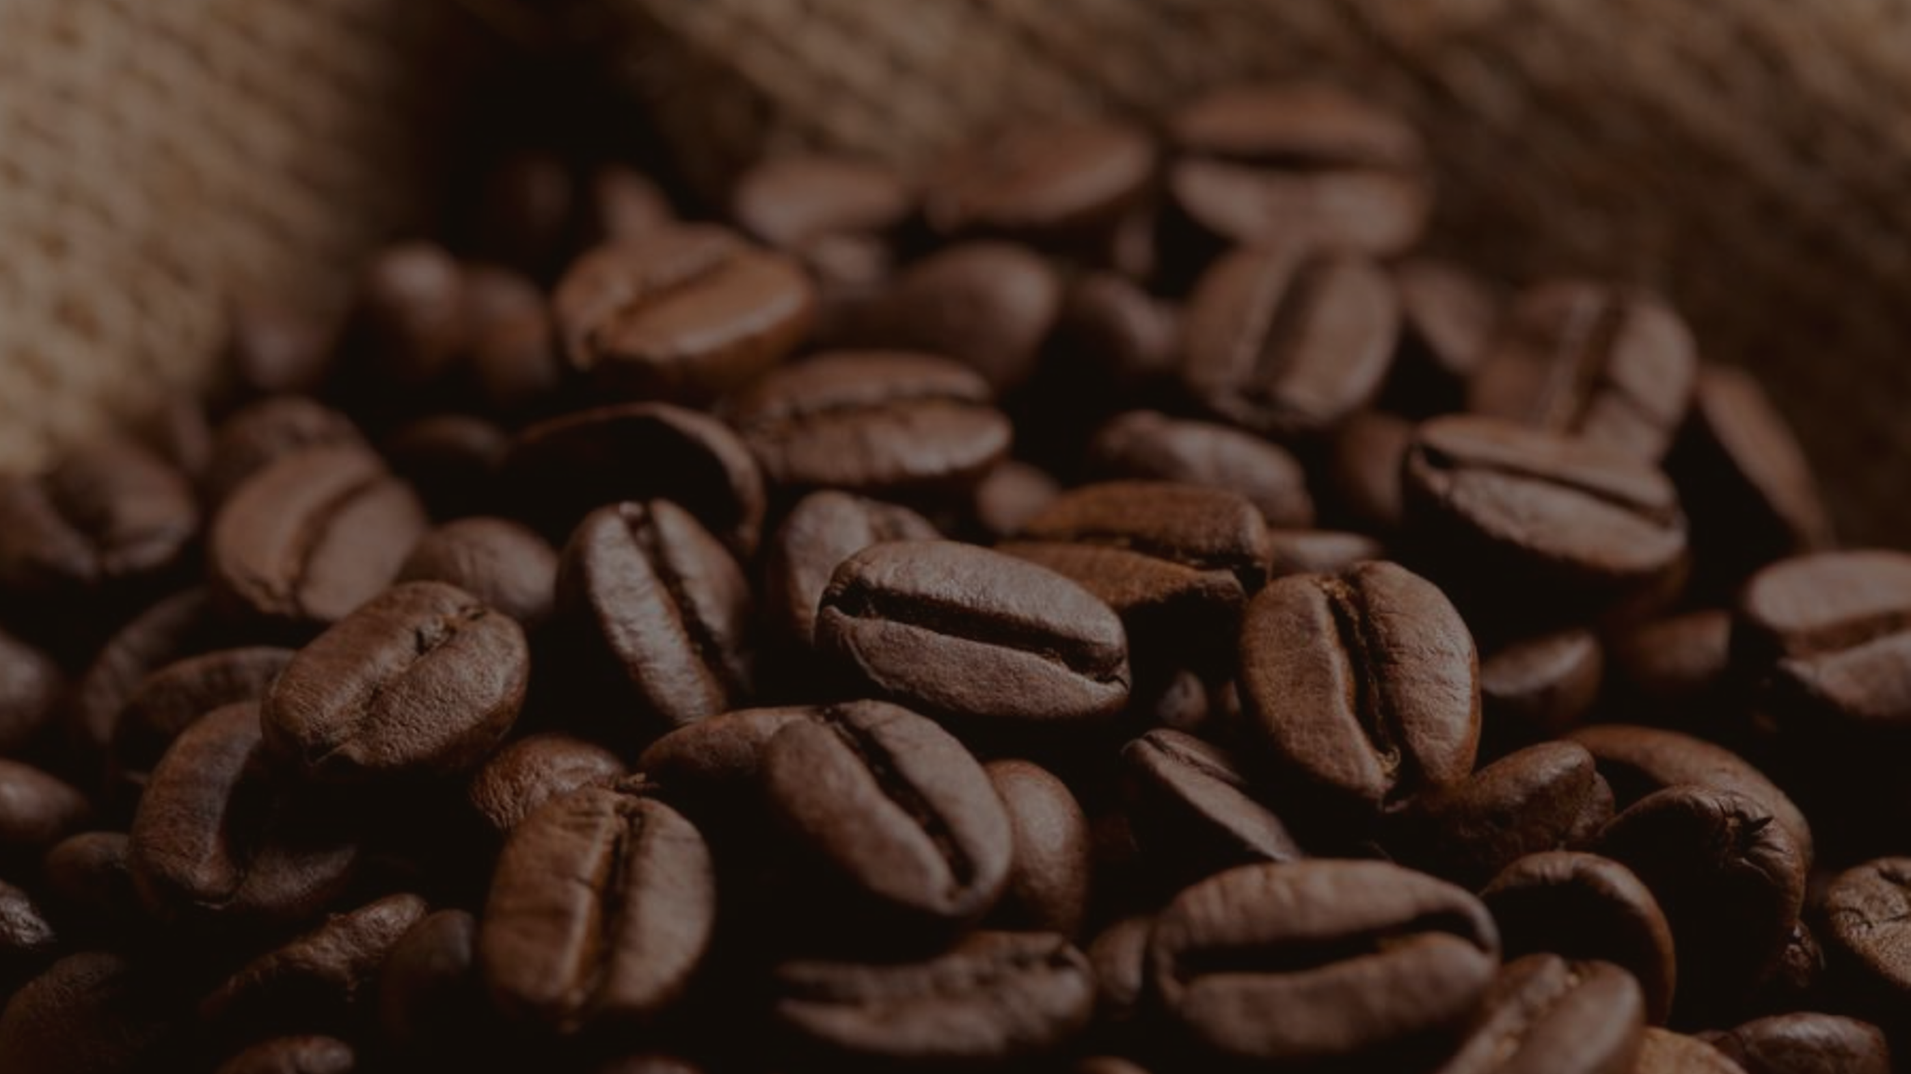
Thank you
Refilwe Mofokeng

